Slide 1

Decentralized Traceability and Direct Selling of Agriculture Supply Chains
by
S. Shabana
Roll No. 204G1A0595
N. Sai Charan Reddy
Roll No. 204G1A0584
G. Sai Pranav Reddy
Roll No. 204G1A0590
C. Sushmitha
Roll No. 204G1A05A6
Under the guidance of
Mr. M. Narasimhulu M.Tech, (Ph.D)
Assistant Professor
Department of Computer Science and Engineering
Srinivasa Ramanujan Institute of Technology
(Autonomous)
2023 - 2024

Slide 2

Contents
Abstract
Problem statement
Objectives of Project
Literature survey for first objective
Literature survey for second objective
Proposed Work - (Methods to be followed for proposed system)
References
GitHub Link
Queries

Slide 3
Abstract
One of the major challenges the agriculture sector is facing today is middlemen fraudulence. These days the process depends on a third party to coordinate the delivery. The involvement of multiple agents adds high costs to the system and makes the entire process time-consuming and vulnerable. In the end, the farmers are left with minimal income, and users may not get quality products.
The idea is to develop a portal for buying and selling agricultural products using IOT technology. The farmers can use this portal to sell their products in a more transparent manner. In this system, it is impossible for middlemen to tamper with the product details.Block chain is the revolutionary technological method, which provides the groundbreaking result for commodity traceableness in agriculture and in food supply chains.This system ensures security through the decentralized structure it provides and thereby reduces the middlemen fraudulence.

Slide 4
Problem Statement
Enhancing Agricultural Supply Chain Efficiency and Minimizing Middlemen Fraudulence through IoT and Blockchain Technology
The current process's depends on multiple agents introduces inefficiencies and vulnerabilities that hinder the growth and prosperity of the agricultural ecosystem.
The traditional supply chains are centralized and they depend on a third party for trading. These centralized systems lack transparency, accountability and auditability. The centralized data storage makes it more difficult to assure Quality, Rate and Origin of the products.
Middlemen, who act as intermediaries, are causing farmers to earn less money for their crops. This is a problem because farmers are the most important part of the farming industry.
People who buy products are not satisfied due to lack of Quality. This is because the way the food gets from the farm to the store isn't very clear or trustworthy.

Slide 5
Objectives of Project
To empower farmers to sell their products in a direct and transparent manner. By eliminating the intermediaries that often exploit the system, farmers can realize higher earnings and regain control over their products journey from farm to consumer.
To create a comprehensive online platform specifically designed for buying and selling agricultural products. By integrating IoT devices and blockchain, this platform seeks to introduce unprecedented levels of transparency, traceability, and security into the agricultural supply chain.

Slide 6
Literature survey for first objective
The traditional supply chains are centralized and they depend on a third party for trading. These centralized systems lack transparency, accountability and auditability. At the same time, consumers are now more interested in food product quality. Farmers are facing lot of problems due to this middlemen fraudulence. Middlemen lends money to the farmers at a very high interest rate. The government is unable to provide the benefits of to farmers as middlemen take away a major chunk of profits.
The traceability of Agriculture food supply chain management is important to ensure the food safety. It also increases the customer satisfaction and peer-to-peer productivity. The centralized data storage makes it more difficult to assure quality, rate and origin of the products. So we are in need of a decentralized system where transparency is available which makes people from the producers to consumers satisfaction.

Slide 7
Literature survey for second objective
The IoT system for agriculture supply chains revolutionises the traditional food distribution process by leveraging advanced technologies. By integrating RFID, weight sensors and blockchain, the system ensures traceability, transparency, and security of the data. The agricultural blockchain solution can reshape farmer-consumer-intermediary dynamics, revolutionizing the industry.
Our proposed framework and solution will focus on the usage of smart contracts executed autonomously on the public blockchain platform. Public blockchain, meaning that the data and transactions are visible to all participants. This promotes transparency, reduces the risk of fraud and ensures integrity in the agriculture food supply chain. The farmers can input their product details and sell directly to the government or any market enterprise. The interface is developed for government officers and the markets to access the farmer’s details and process transactions.

Slide 8
Proposed System
The proposed system provides a direct selling from farmer to government.
This system contains a microcontroller, RFID reader and weight sensor. The RFID tags in every food grain bags, when farmer enter the selling place to their products, the government officers fetch the details of the farmers using RFID reader and also the details of farmer are updated in IOT webpage. The weight sensor is used to measure the weight of the food grains. Every farmer has unique RFID tags so identifying the farmer is easy and also the details are updated in web page so the intermediates are avoided.
Block chain is a distributed database containing all networked transactions. Each part of this database is a “block”, a block with a connection to the previous block is added to the block chain in a linear and sequential order. Then the new block is replicated over the network, so that each node has the same block chain. Ethereum is a public blockchain, meaning that the data and transactions are visible to all participants. This promotes transparency and reduces the risk of fraud.

Slide 9
References
M. M. Aung and Y. S. Chang, ``Traceability in a food supply chain: Safety and quality perspectives,'' Food Control, vol. 39, pp. 172_184, May 2014.
[2] T. Bosona and G. Gebresenbet, ``Food traceability as an integral part of logistics management in food and agricultural supply chain,'' Food Control, vol. 33, no. 2, pp. 32_48, 2013.
[1] M. M. Aung and Y. S. Chang, “Traceability in a food supply chain: Safety and quality perspectives,” Food Control, vol. 39, pp. 172_184, May 2014.

Slide 10
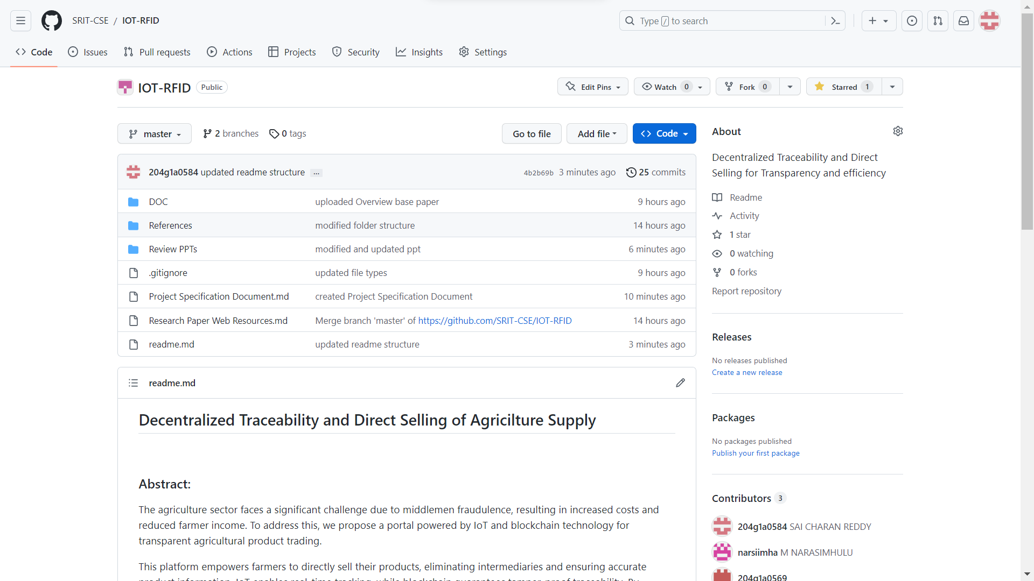
GitHub Dashboards of each student

Slide 11
Any Queries?

